Slide 1
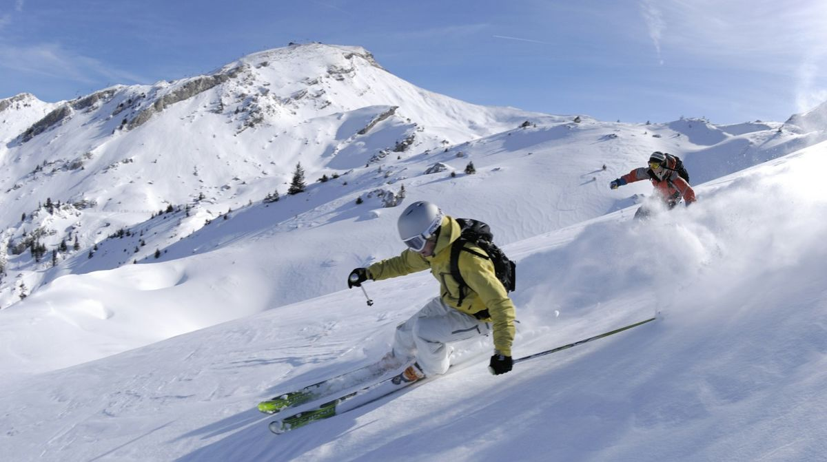
Big Mountain Revenue Spotlight: Predicting Ski Resort Ticket Prices Based on Market Data
Divya Singh
Photo Source: Robinseed, CC BY-SA 4.0 <https://creativecommons.org/licenses/by-sa/4.0>, via Wikimedia Commons

Slide 2
Problem and Hypothesis
Big Mountain is currently not using a data-driven approach toward setting ticket prices, giving concern to resort profitability given rising operating expense forecasts
This analysis serves to answer two questions:
  Can we build a model to measure how Big Mountain tickets can be priced based on the facilities available at the resort and information we have about market competitors?
  How much would Big Mountain need to increase ticket prices to offset the incremental seasonal operating cost of an additional chairlift?
Based on data availability, we chose to focus this analysis on the impact to Adult Weekend ticket prices, and the model has been tailored to measure this KPI
Model’s focus is adjusting revenue rather than on adjusting operating expenses

Slide 3
Key Findings
Big Mountain currently charges $81.00 per adult weekend ticket. Our random forest regressor model suggests that Big Mountain's facilities can support a ticket price of $95.87.
  The model reflects a mean absolute error of $10.39
  This suggests there is room for an increase of $4.48 per ticket
The results also indicate that when assuming each visitor on average buys 5 day tickets, Big Mountain can raise ticket prices by $1.99/ticket to offset increased operating expenses associated with the new lift

Slide 4
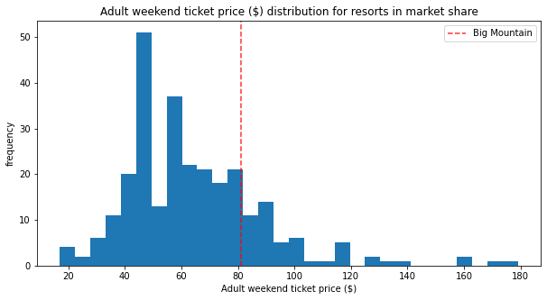
Modeling Results and Analysis
Initially started with a CSV containing data for 330 ski resorts across 35 states
  The adjacent plot depicts how Big Mountain’s $81 ticket price for adult weekend tickets compares against those of the selected competitors

Slide 5
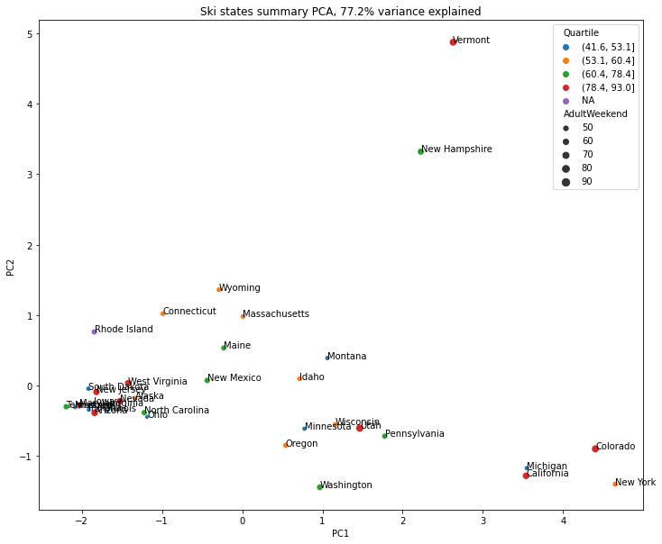
Modeling Results and Analysis (cont’d)
We performed some exploratory analysis to assess whether a resort’s state location was correlated with ticket price. Per the adjacent plot, there did not seem to be a strong correlation.
  As such, resorts were not treated differently in the analysis based on their state location

Slide 6
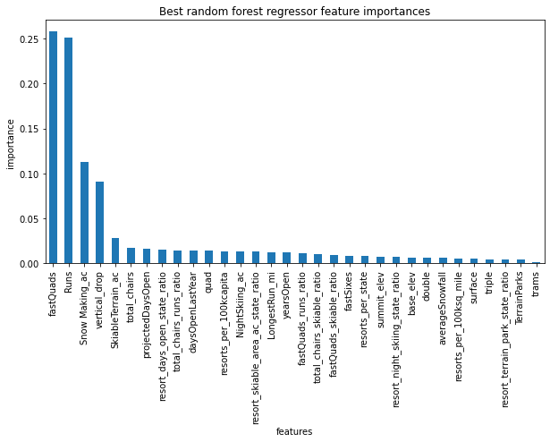
Modeling Results and Analysis (cont’d)
Ultimately we chose a random forest regressor model to predict ticket prices
  Compared to using the mean and using a linear regression model, a random forest regressor had the lowest mean absolute error between predictions and actuals
  The adjacent plot depicts the magnitude of influence each ski resort attribute had on the results of the random forest regressor model.
    fastQuads, Runs, Snow Making_ac, and vertical_drop are among the most impactful attributes

Slide 7
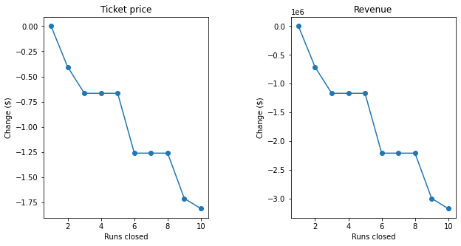
Modeling Results and Analysis (cont’d)
Upon using the random forest regressor model, we find that the data supports an increase of adult weekend ticket prices by about $4.48.
The adjacent plot illustrates the model’s estimation of how much Big Mountain could reduce ticket prices to maintain the same level of profitability when closing 1-10 runs
If Big Mountain is adding a run, increasing the vertical drop by 150 feet, and installing an additional chair lift, we estimate that Big Mountain would need to increase ticket prices by $1.99 per ticket to offset the increased costs (on the basis of each visitor on average buying 5 tickets)
The following scenarios drove no change to predicted ticket prices:
  Adding 2 acres of snow making to the previous scenario
  Increasing the longest run by .2 miles and guaranteeing its snow coverage by adding 4 acres of snow making capability.

Slide 8
Summary and Conclusion
The analysis supports an increase of Big Mountain adult weekend ticket prices
  Big Mountain should consider performing similar analysis focusing on adult weekday ticket prices and children’s ticket prices to understand whether there is a quantitative argument for adjusting those revenue streams as well
The current analysis reflects a specific point in time. Big Mountain should consider performing this analysis on a regular basis to verify whether the conclusion holds based on revolving market parameters.

